Slide 1

Airline Project
Submitted By Ankit

Slide 2
Introduction
This airline Rating system project aims to Develop a comprehensive system that evaluates and rates various airline based on different criteria .The airline rating system project aims to enhance transparency and empower passengers with valuable insights for a better travel experience. This project will provide a user-friendly platform where users can access detailed ratings, reviews, and comparisons of airlines, considering factors like safety records, customer service, on-time performance, amenities, and more.
The datasets also includes ratings for factors like route network, accessibility, family friendliness.

Slide 3
Contents
1.INTRODUCTION…
2.COLUMNS DISCRIPTION…
3.IMPORTING LIBRARIES
4.Problem Occurred
5.IMPORTING DATA…
6.DATA ANALYSIS…
7.CONCLUSION…

Slide 4
Columns Descriptions
1.ID: Unique passenger identifier
2.Gender: Gender of the passenger (Female/Male)
3.Age: Age of the passenger
4.Customer_Type: Type of airline customer (First-time/Returning)
5.Travel_Type: Purpose of the flight (Business/Personal)
6.Travel Class: Travel class in the airplane for the passenger seat
7.Flight Distance: Flight distance in miles
8.Departure Delay: Flight departure delay in minutes
9.Arrival Delay: Flight arrival delay in minutes
10.Departure and Arrival Time Convenience: Satisfaction level with the convenience of the flight departure and arrival times from 1 (lowest) to 5 (highest) - 0 means "not applicable“
11.Ease of Online Booking: Satisfaction level with the online booking experience from 1 (lowest) to 5 (highest) - 0 means "not applicable"
12.Check-in Service: Satisfaction level with the check-in service from 1 (lowest) to 5 (highest) - 0 means "not applicable"
13.Online Boarding: Satisfaction level with the online boarding experience from 1 (lowest) to 5 (highest) - 0 means "not applicable"
14.Gate Location: Satisfaction level with the gate location in the airport from 1 (lowest) to 5 (highest) - 0 means "not applicable"
15.On-board Service: Satisfaction level with the on-boarding service in the airport from 1 (lowest) to 5 (highest) - 0 means "not applicable"
16.Seat Comfort: Satisfaction level with the comfort of the airplane seat from 1 (lowest) to 5 (highest) - 0 means "not applicable“
17.Leg Room Service: Satisfaction level with the leg room of the airplane seat from 1 (lowest) to 5 (highest) - 0 means "not applicable"

Slide 5
18.Cleanliness: Satisfaction level with the cleanliness of the airplane from 1 (lowest) to 5 (highest) - 0 means "not applicable“
19.Food and Drink: Satisfaction level with the food and drinks on the airplane from 1 (lowest) to 5 (highest) - 0 means "not applicable“
20.In-flight Service: Satisfaction level with the in-flight service from 1 (lowest) to 5 (highest) - 0 means "not applicable“
21.Wi fi Service: Satisfaction level with the in-flight Wifi service from 1 (lowest) to 5 (highest) - 0 means "not applicable“
22.In-flight Entertainment: Satisfaction level with the in-flight entertainment from 1 (lowest) to 5 (highest) - 0 means "not applicable“
23.Baggage Handling: Satisfaction level with the baggage handling from the airline from 1 (lowest) to 5 (highest) - 0 means "not applicable“
24.Satisfaction: Overall satisfaction level with the airline (Satisfied/Neutral or unsatisfied)

Slide 6
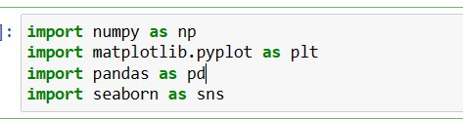
Libraries Imported
Numpy: NumPy is a powerful Python library used in scientific computing and data analysis. It provides multi-dimensional array objects, mathematical functions, linear algebra operations, random number capabilities .
Pandas: Pandas is a widely-used open-source Python library for data manipulation and analysis. It provides data structures and functions that are designed to make working with structured data fast, efficient, and easy.

Slide 7
Seaborn: Seaborn is a popular data visualization library built on top of Matplotlib, which makes it easier to create visually appealing and informative statistical graphics. It provides a high-level interface for creating a variety of statistical visualizations with concise and expressive syntax.
Matplotlib: Matplotlib is a popular and widely used data visualization library in Python. It provides a comprehensive set of tools for creating a wide range of static, animated, and interactive visualizations. With Matplotlib, you can generate various types of plots, charts, and graphs to explore and communicate your data effectively.

Slide 8
Problem Occurred
The only major Problem I face in this Project That there were not available the Name of the Columns .Firstly I give the name to the Columns according to me.
There were some null values in data so I remove the all null values from the data using by Python Pandas Library.

Slide 9
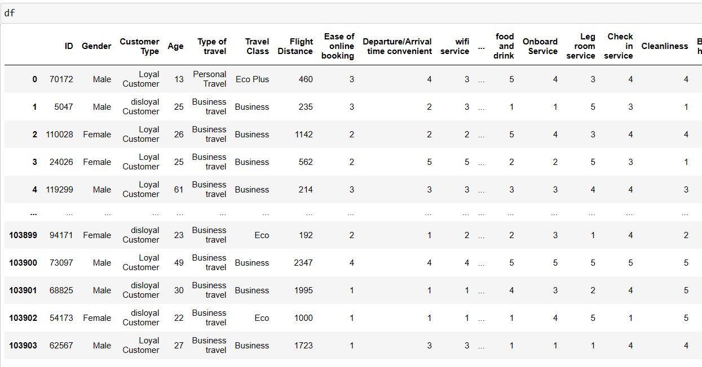
Importing data

Slide 10
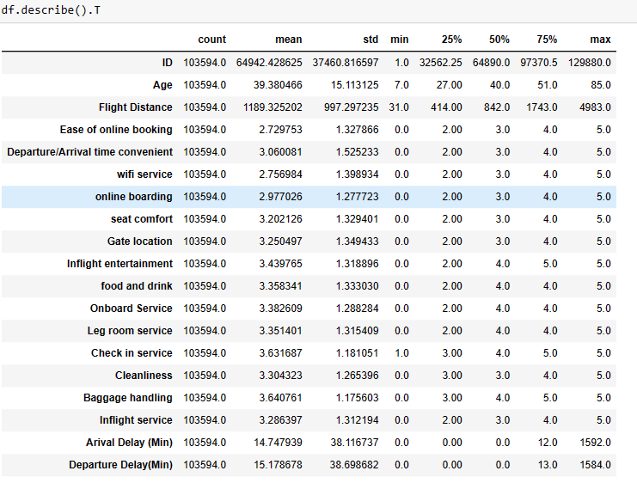
Data Analysis
Get summary information about quantitative features by calling the "describe" method with default parameters:

Slide 11
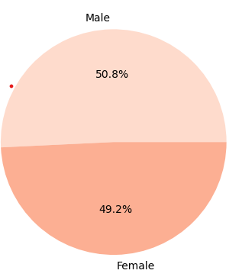
For each quantitative attribute, mean values, standard deviation, minimum and maximum values, median and quartile values, 25%,50%,75% are given.
Insight:1>>Total Number of gender
Female 52576
Male 51018
Name: Gender, dtype: int64
From this insight we are able to find the total number of gender with number and percentage

Slide 12
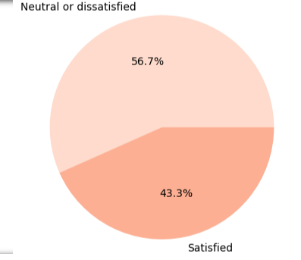
Insight 2. Satisfaction Value¶
Neutral or dissatisfied : 58697
satisfied : 44897
Name: satisfaction, dtype: int64
From this insight we are able to find the Total number of satisfaction.
In this data 43.3% customers are who are satisfied and 56.7% customers are who are dissatisfied.

Slide 13
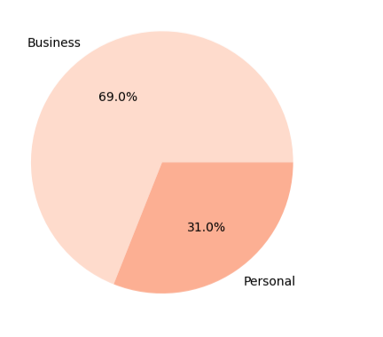
Insight 3. Type of travels
Business travel : 71465
Personal Travel : 32129
Name: Type of travel, dtype: int64
From this insight we can find the total number and percentage of customers according to Types of travel
As if here 69% customers prefer to business travel.
31% customers prefer to Personal travel.

Slide 14
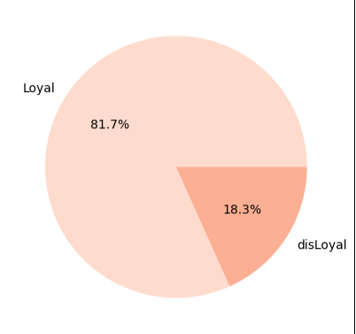
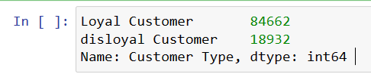
Insight 4. Type of Customers
From this insight, We can able to find Total number and percentage of type of customers.
As if here the total number of Loyal customers is 84662 and percentage is 81.7%.
The total number of Disloyal customers is 18932 and percentage is 18.3%.

Slide 15
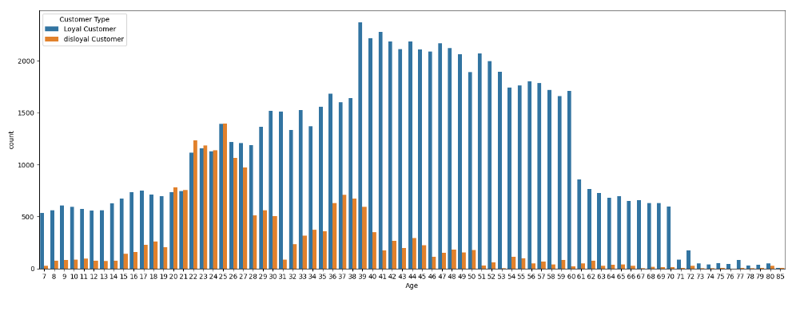
Insight 5. Customer Types according to age
From this insight we can able to find the count of Passanger’s Loyality According to age.
Most of passengers are from 22 to 60 years old.
Most of passengers that are Loyal customer, Belongs to 35 to 60 years old.
Most of passengers that are Disloyal customer, Belongs to 20 to 27 years old

Slide 16
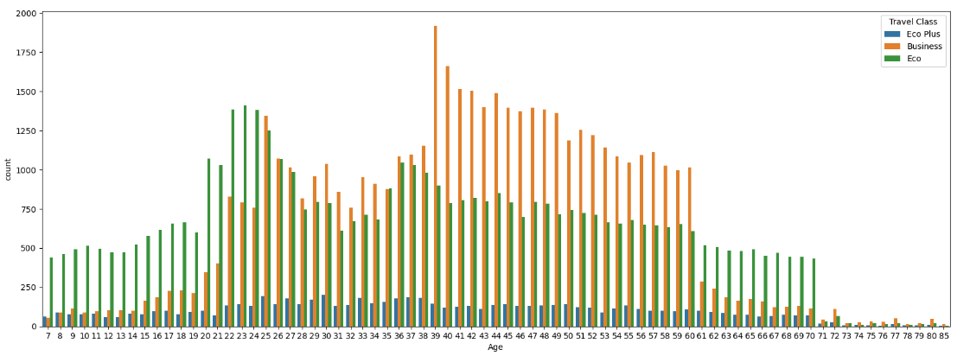
Insight 6. Travel Class counts According to age
From this insight we can able to find the Number of customers ( Travel class) according to the age.
Most of Young passenger travel in eco class.
Most of Adult passenger travel in business class.

Slide 17
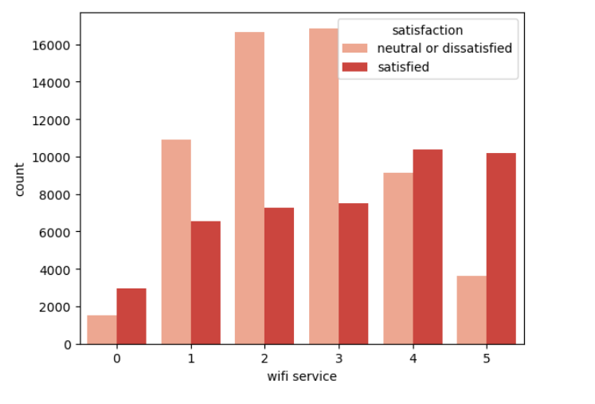
Insight 7.Find Value of satisfaction according to Ratings at Wi fi service
According to this graph, We can see that all passengers who rated the Wi fi service 5 out of 5 points were satisfied with the flight

Slide 18
Conclusion
There are many reasons for customer’s Dissatisfaction.
So are Many of customers, who are loyal then they get 1 to 2 ratings from the 5 and many of customers are, who are disloyal then give the 5 to 5 ratings.
So Many customers are who rated the Wi fi service 5 out of 5 points were satisfied with the flight . It means that they were able to use wifi service properly.
Hence we should focus on that points which impact at the ratings and try to provide to best services at the same.

Slide 19

Regards,
Ankit Gangwar

